Slide 1

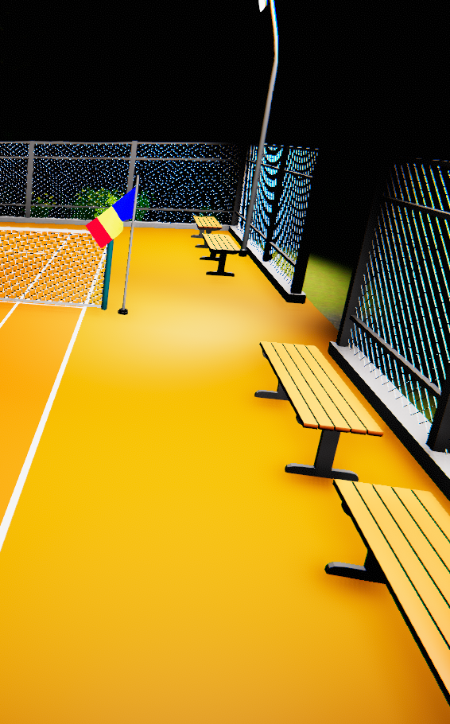
TENNIS APP PITCH DECK
PROIECT DJC –
2024 Unitbv

Slide 2
AGENDA
I.
II.
INTRODUCTION
ABOUT THE PRODUCT
III.
IV.
OUR TEAM
PRODUCT DEMO

Slide 3
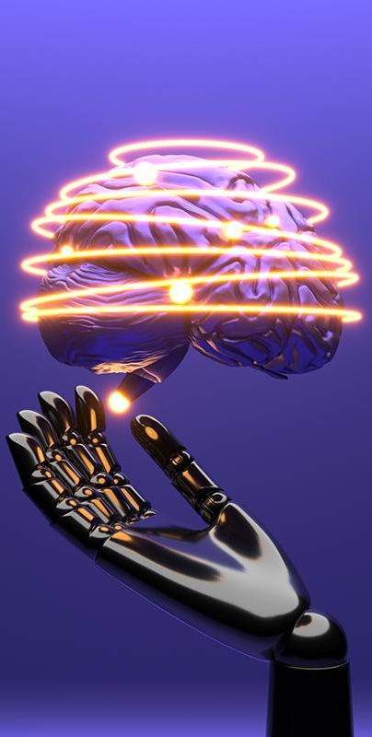
INTRODUCTION
I.
Unity project with detailed character animations, dynamic environments, comprehensive UI, and interactive game mechanics.

Slide 4
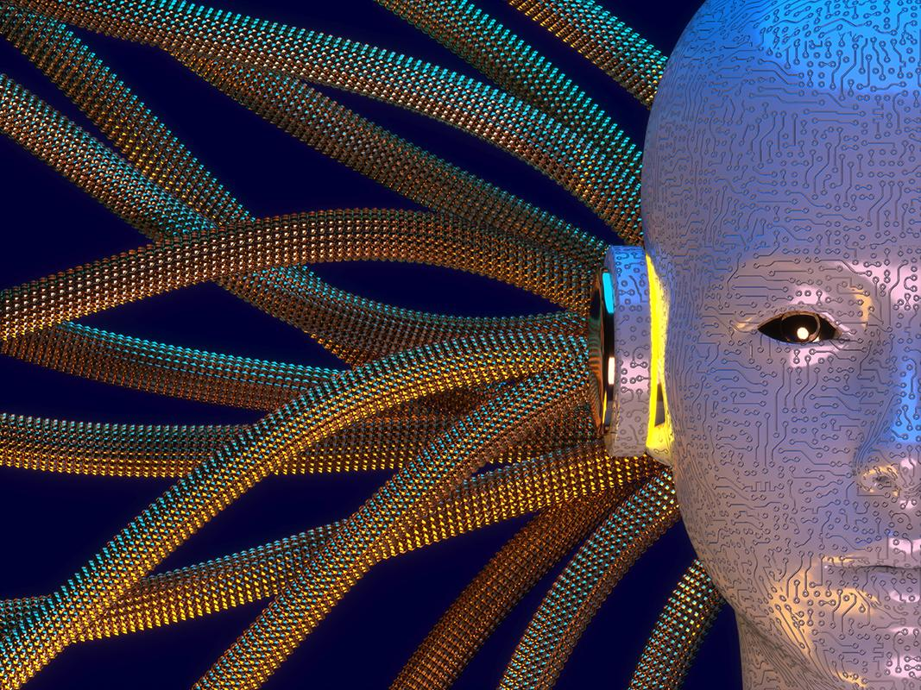
II.
ABOUT THE PRODUCT

Slide 5

– COSMIN DOBRE
project setup
basic player movement
main menu
world environment (shaders + lights + wind + post processing effects)
day & night system

Slide 6
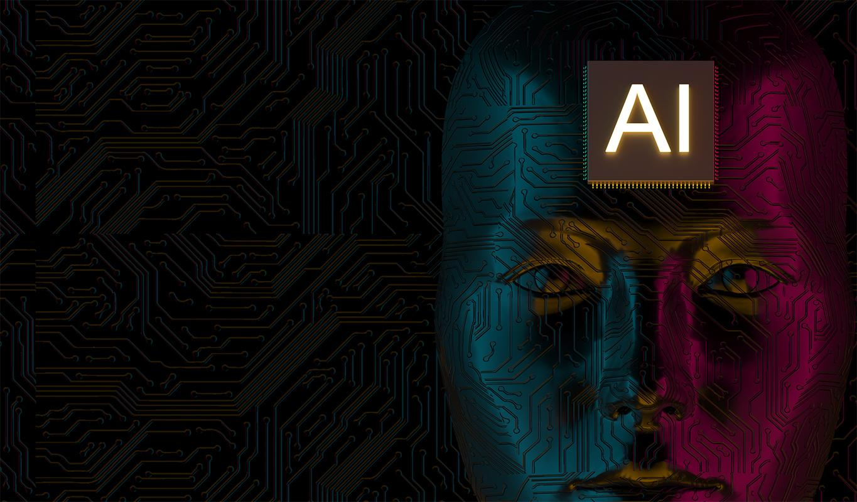
– CONSTANTIN THEODOR
basic hitting ball system
ball particles
AI bot
world environment (shaders + lights + wind + post processing effects)

Slide 7
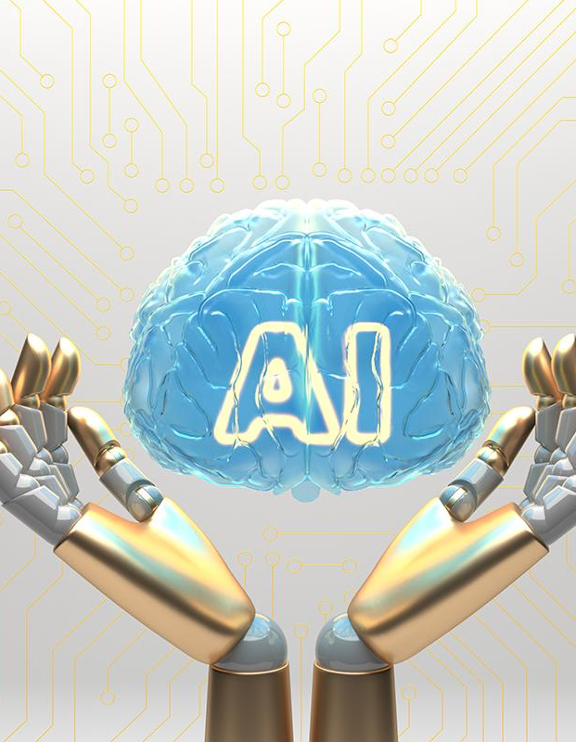
– ALEXANDRU ANTOHI
scoring system
improved ball hitting system
improved gameplay
sound manager

Slide 8
OUR TEAM
III.
CONSTANTIN THEODOR
COSMIN
DOBRE
ALEXANDRU
ANTOHI

Slide 9
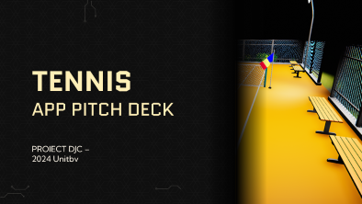
PRODUCT DEMO
IV.

Slide 10
THANKS!
Does anyone have any questions?

